Slide 1
_{Business function}
_{Task analysis}

Slide 2
BUSINESS FUNCTION-TASK ANALYSIS
SUBMITTED BY -PALLAVI MAHAJAN
(IT-2 K 19-40)
SUBMITTED TO - DR SHALIGRAM PRAJAPAT

Slide 3
About
Developed by IBM in the 1960s to establish the relationships between an organization’s data, processes, and organizational units

Slide 4
What is bussiness function

Slide 5

Business functions are the activities carried out by an enterprise; they can be divided into core functions and support functions

Slide 6
What is Task analysis

Slide 7
Task analysis
Task analysis involves breaking down user’s activities to the individual task level.The goal is to obtain an understanding of why and how people currently do the things that will be automated.
1

Slide 8
Focus group
Managers from all the functional units in the entire company

Slide 9

THE 5W ANALYSIS

Slide 10
How?
HOW IS THE INFORMATION USED HOW IS THE INFORMATION
PROCESSED AND/OR STORED?

Slide 11
Where?
WHERE DOES THE
INFORMATION ORIGINATE?
WHERE IS THE
INFORMATION DELIVERED?
WHERE IS THE INFORMATION USED AND/OR MODIFIED?

Slide 12
What objectives are
associated with the
What?
information?
What are the data needs of the participants?

Slide 13
Who
WHO CREATES THE DATA OR INFORMATION?
WHO ARE THE MAJOR USERS OF THE DATA?
WHO IS AUTHORIZED TO UPDATE AND/OR MAINTAIN THE DATA?

Slide 14
When?
WHEN AND IN WHAT FORM ARE THE DATA NEEDED?
WHEN ARE THE DATA DISTRIBUTED TO OTHER BRANCHES?

Slide 15
AFTER THE 5W ANALYSIS SURVEY IS
COMPLETED, AN ORGANIZATIONAL UNIT PROCESS MATRIX IS CONSTRUCTED

Slide 16
organizational unit-process
matrix
The purpose of the organizational unit- process matrix is to identify the relationships between the organizational units and the processes and to
determine the degree of involvement of the various units in specific processes..
1

Slide 17
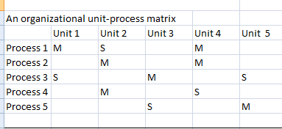

Slide 18
The process-data element
matrix
A table that shows the relationships between the data elements and the processes..
1

Slide 19
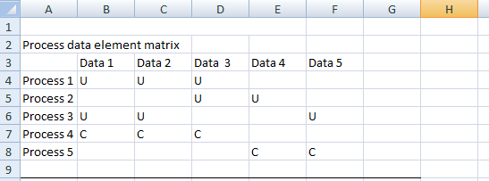

Slide 20
Data analysis
ANALYZING THE WEALTH OF INFORMATION SUMMARIZED IN THE UNIT-PROCESS MATRIX
AND THE PROCESS-DATA ELEMENT MATRIX OFTEN REVEALS INDIRECT RELATIONSHIP
BETWEEN THE ORGANIZATIONAL UNITS,

Slide 21
Thank you!

